Slide 1

Automated Hyperspectral Pyrometry of Bulk Crystal Growths
Naman Parikh¹, Tyrel McQueen^{2,3}, David Elbert^{4,5}
¹Carnegie Mellon University, ²Johns Hopkins University, ³PARADIM, ⁴Hopkins Extreme Materials Institute, ⁵Institute for Data Intensive Engineering and Sciences

Slide 2
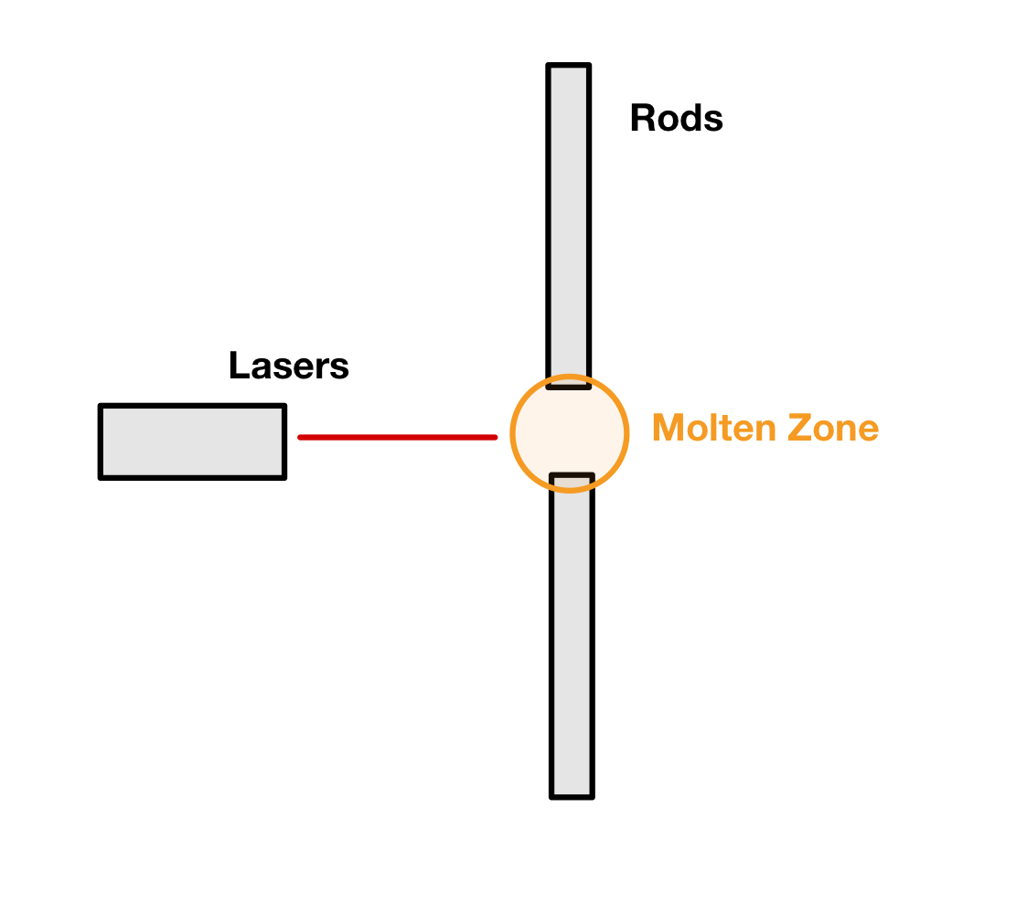
Floating Zone Furnaces

Slide 3
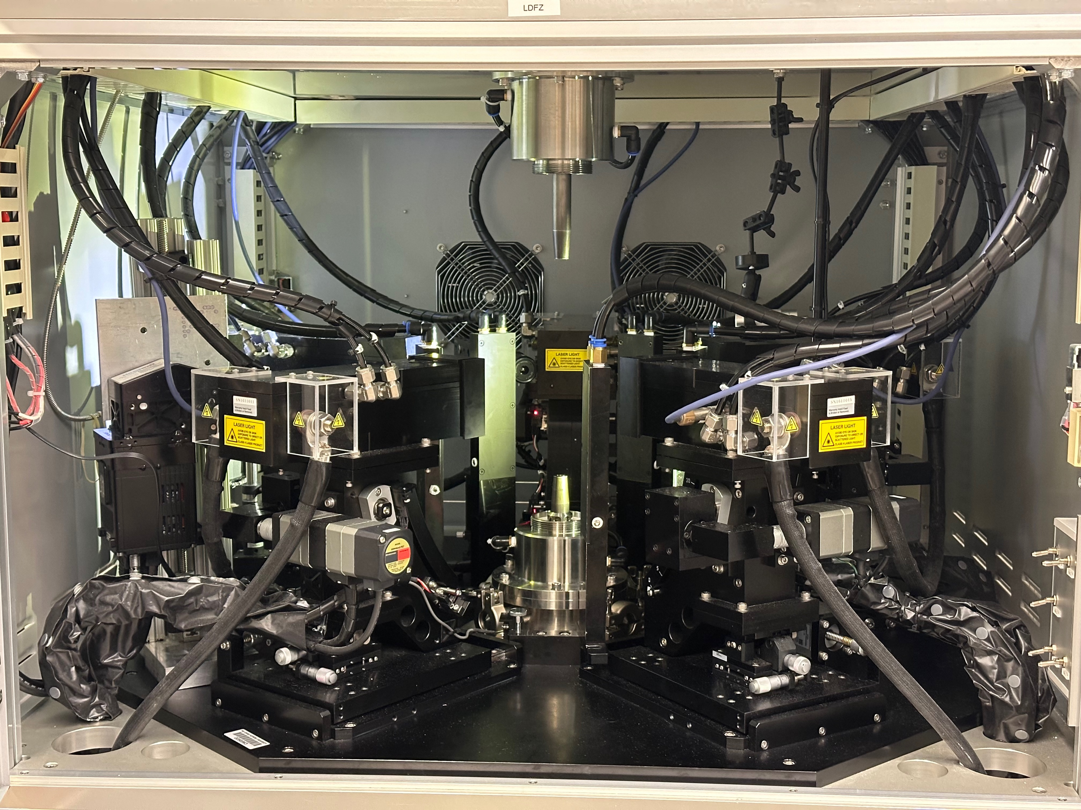

Slide 4
Uses / Benefits

Slide 5
Physics of the Molten Zone / Models

Slide 6
Temperature is Critical Parameter

Slide 7
Past Work

Slide 8
Molten Zone Temperature
Crystal Properties
Notes:
The temperature and the thermal distribution will affect the properties of the crystal we grow, but we don’t know exactly how. If we did, we could reverse engineer what we want the thermal distribution should look like during a growth. If we could have a live feed of the thermal distribution, we could compare what we have to what we want. From there we would want to know how to get what we want and how to make adjustments if needed

Slide 9
Materials Used:
Chemical Properties
Molten Zone Temperature
Furnace Controls:
Rotation Speed
Pull Rate

Slide 10
Materials Used:
Chemical Properties
Molten Zone Temperature
Crystal Properties
Furnace Controls:
Rotation Speed
Pull Rate
Notes:
Once we have the knowledge going forward, we can go backwards, using temperature of the molten zone as a middleman to figure out how to get the crystal properties we want and use that information to make adjustments in real time
Here I need to explain why this model means that we need to be able to collect temperature data in real time

Slide 11
We need real-time data
Notes:
What do we need to make this happen?

Slide 12
Research Question

Slide 13
Research Question
How can we measure the temperature of an ongoing growth?

Slide 14
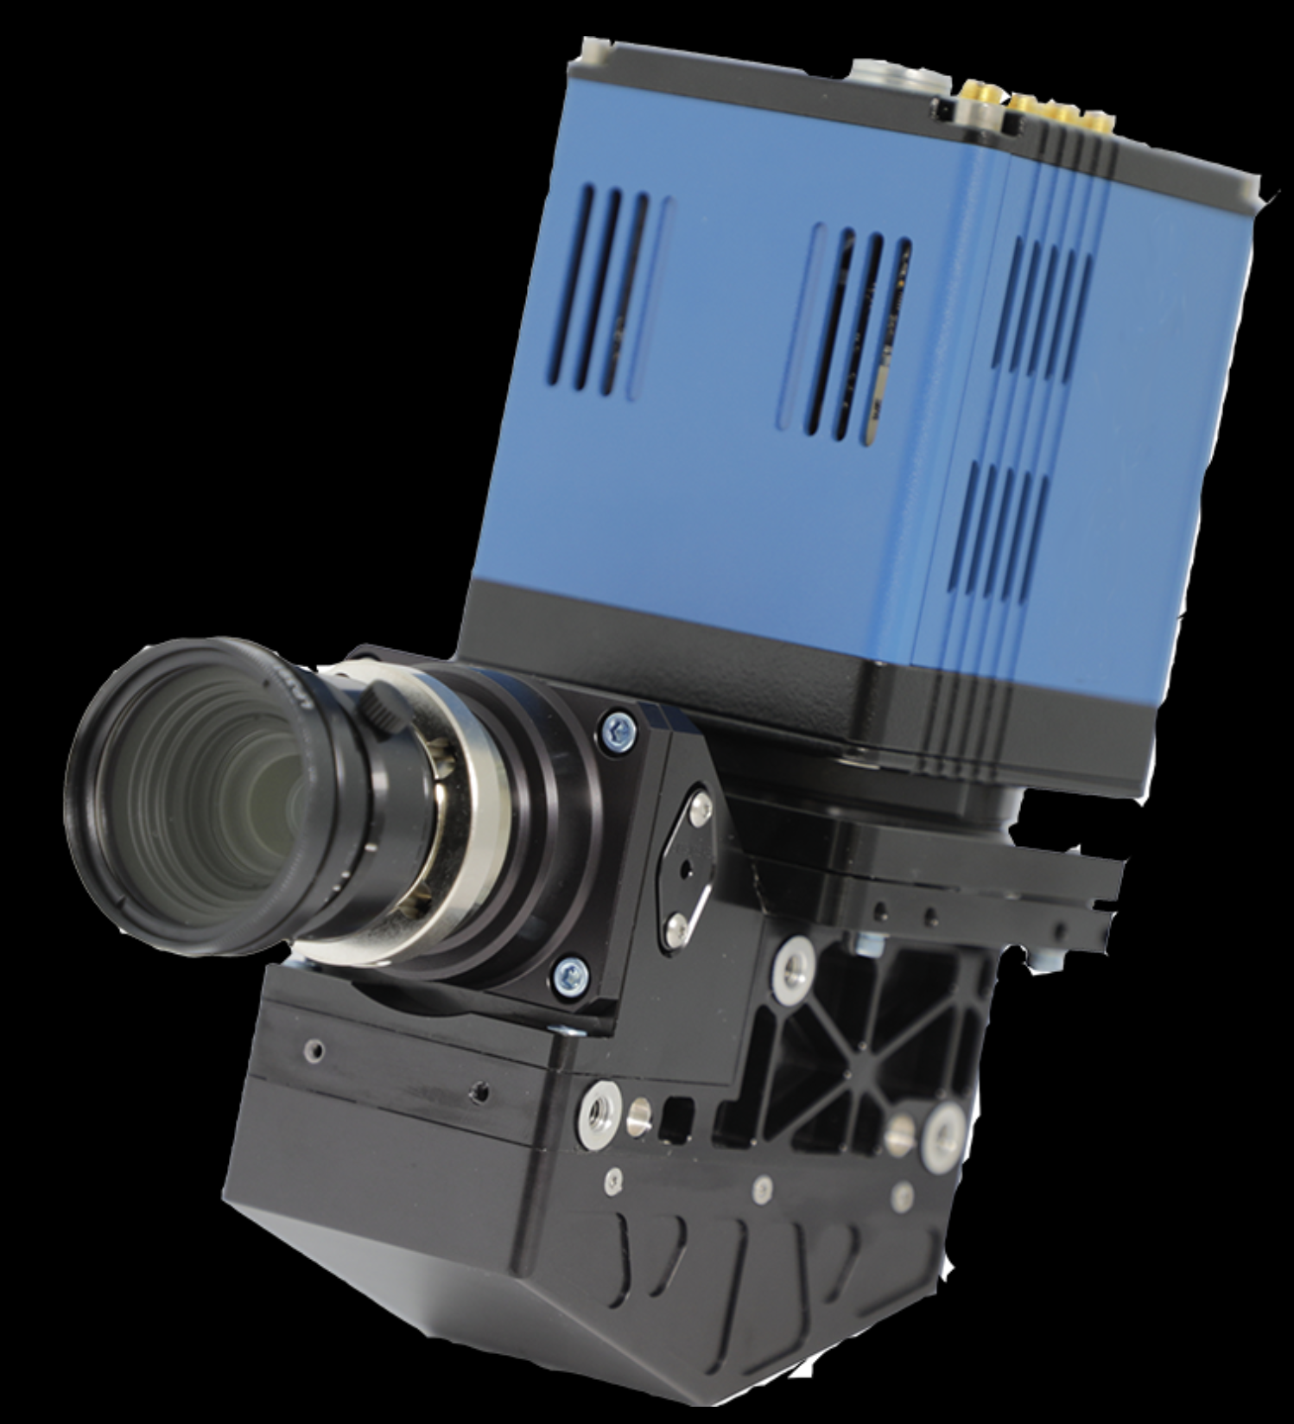
Hyperspectral Camera
Notes:
Ours is not blue :(

Slide 15
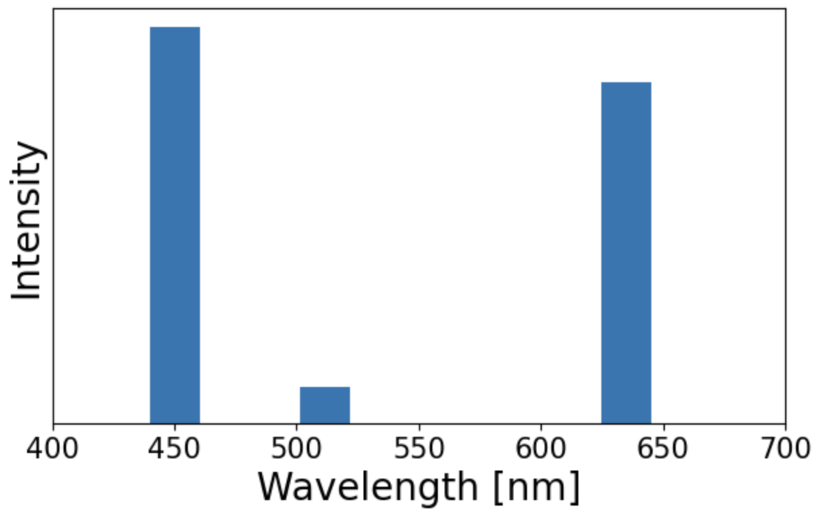
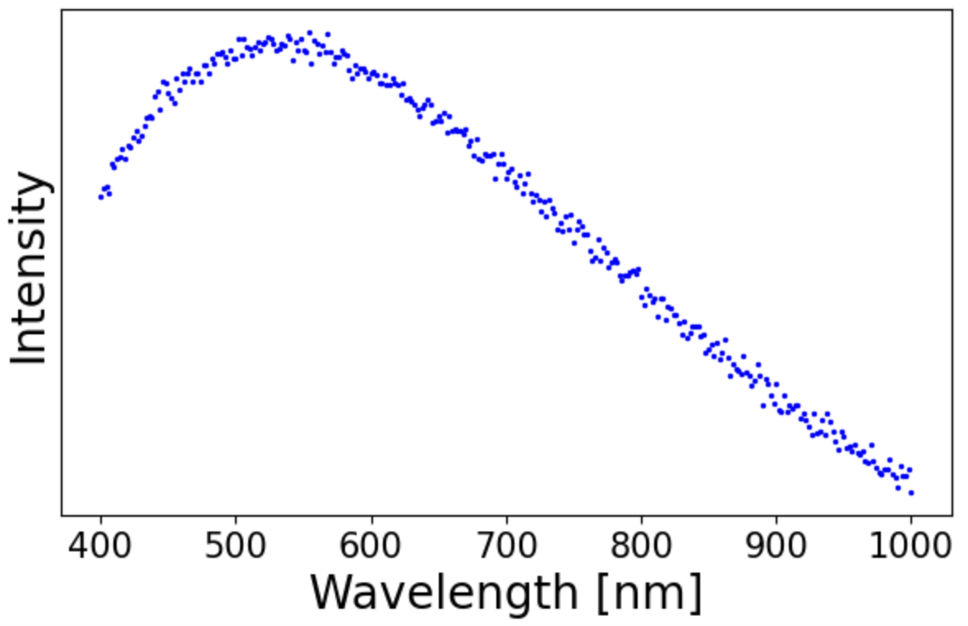
Hyperspectral
Traditional

Slide 16
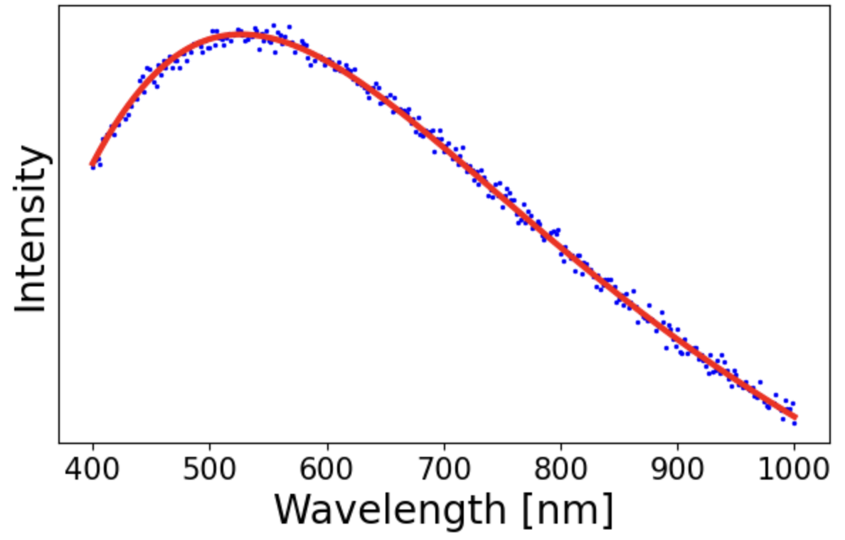
Why hyperspectral?
Notes:
With more than 3 wavelengths, we can make interpolate the data into a blackbody radiation spectrum. The exact shape of a spectrum uniquely determines the temperature, so using some machine learning on this will get us temperature values for each pixel

Slide 17
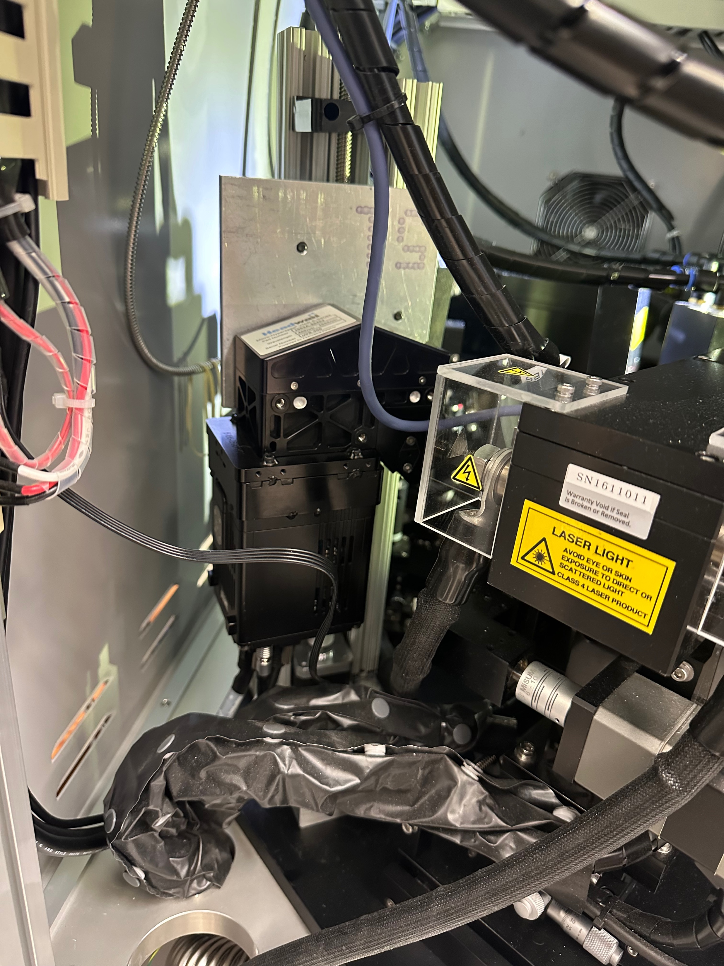
Part 1: Physical Mount

Slide 20
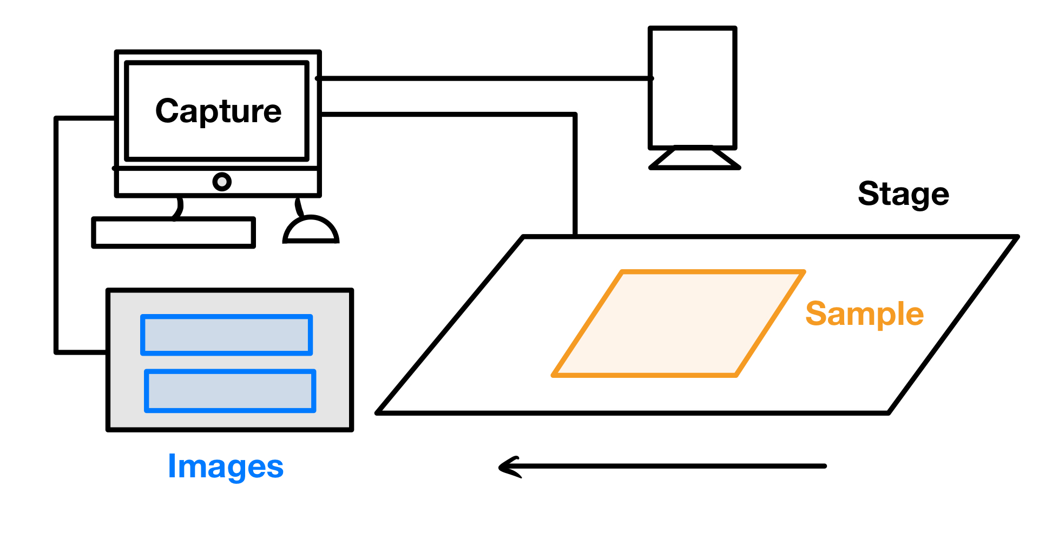

Slide 21
The camera needs to move!

Slide 22
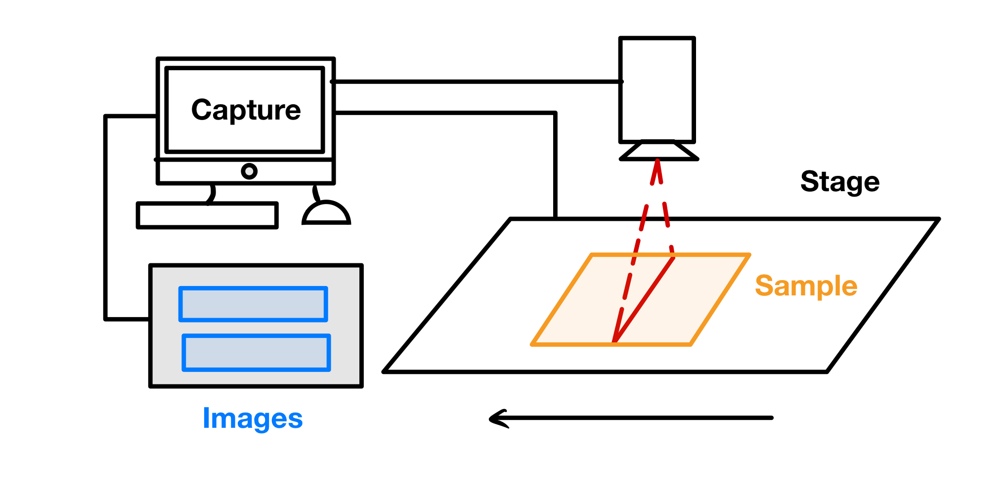
Notes:
Why does it need to move?
Important to note that the computer syncs the start of the image capture and the movement of the stage

Slide 23
Picture of scanning stage

Slide 24
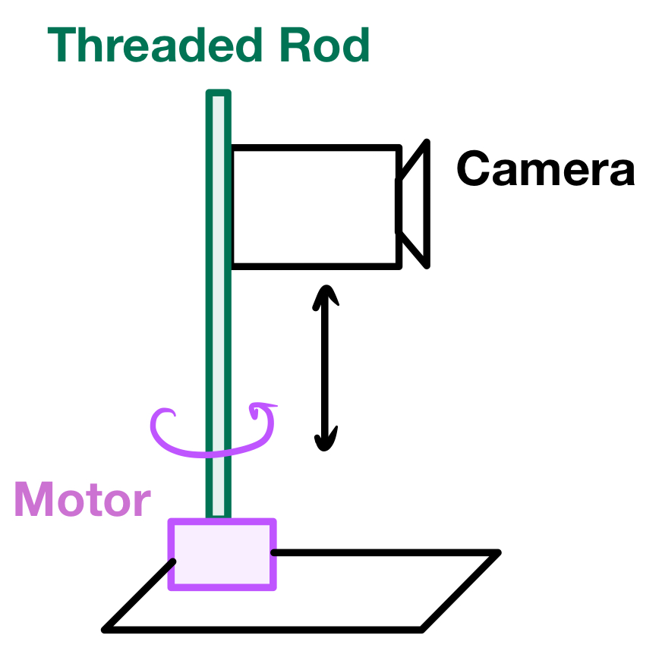
Notes:
How do we make it scan?

Slide 25
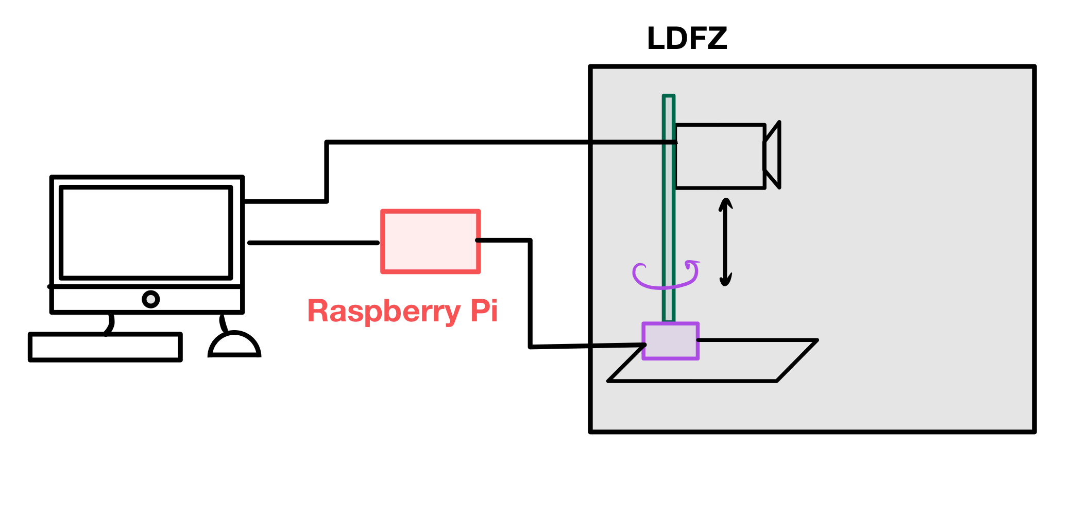
Notes:
How do we sync the motor with the image capture? We are replacing the stage with the motor

Slide 26
R-Pi mimics the stage
Signals from stage

Slide 27
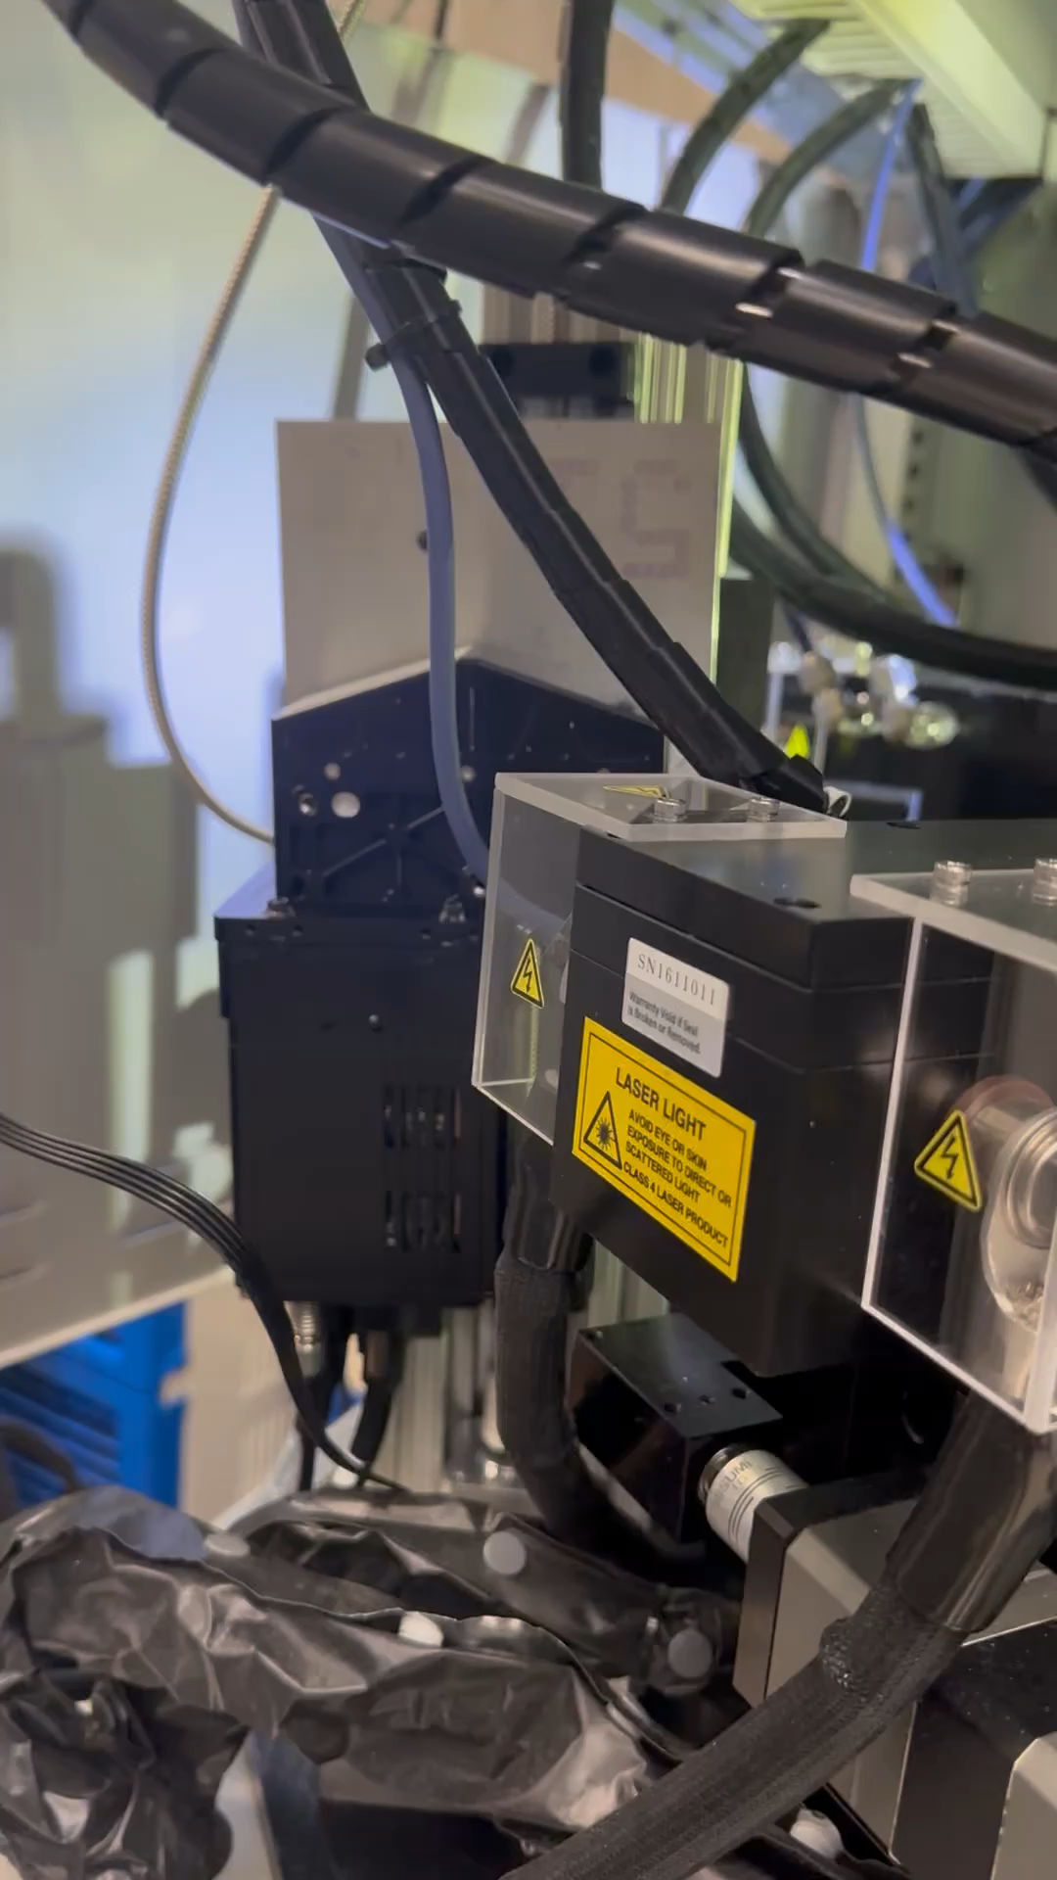

Slide 28
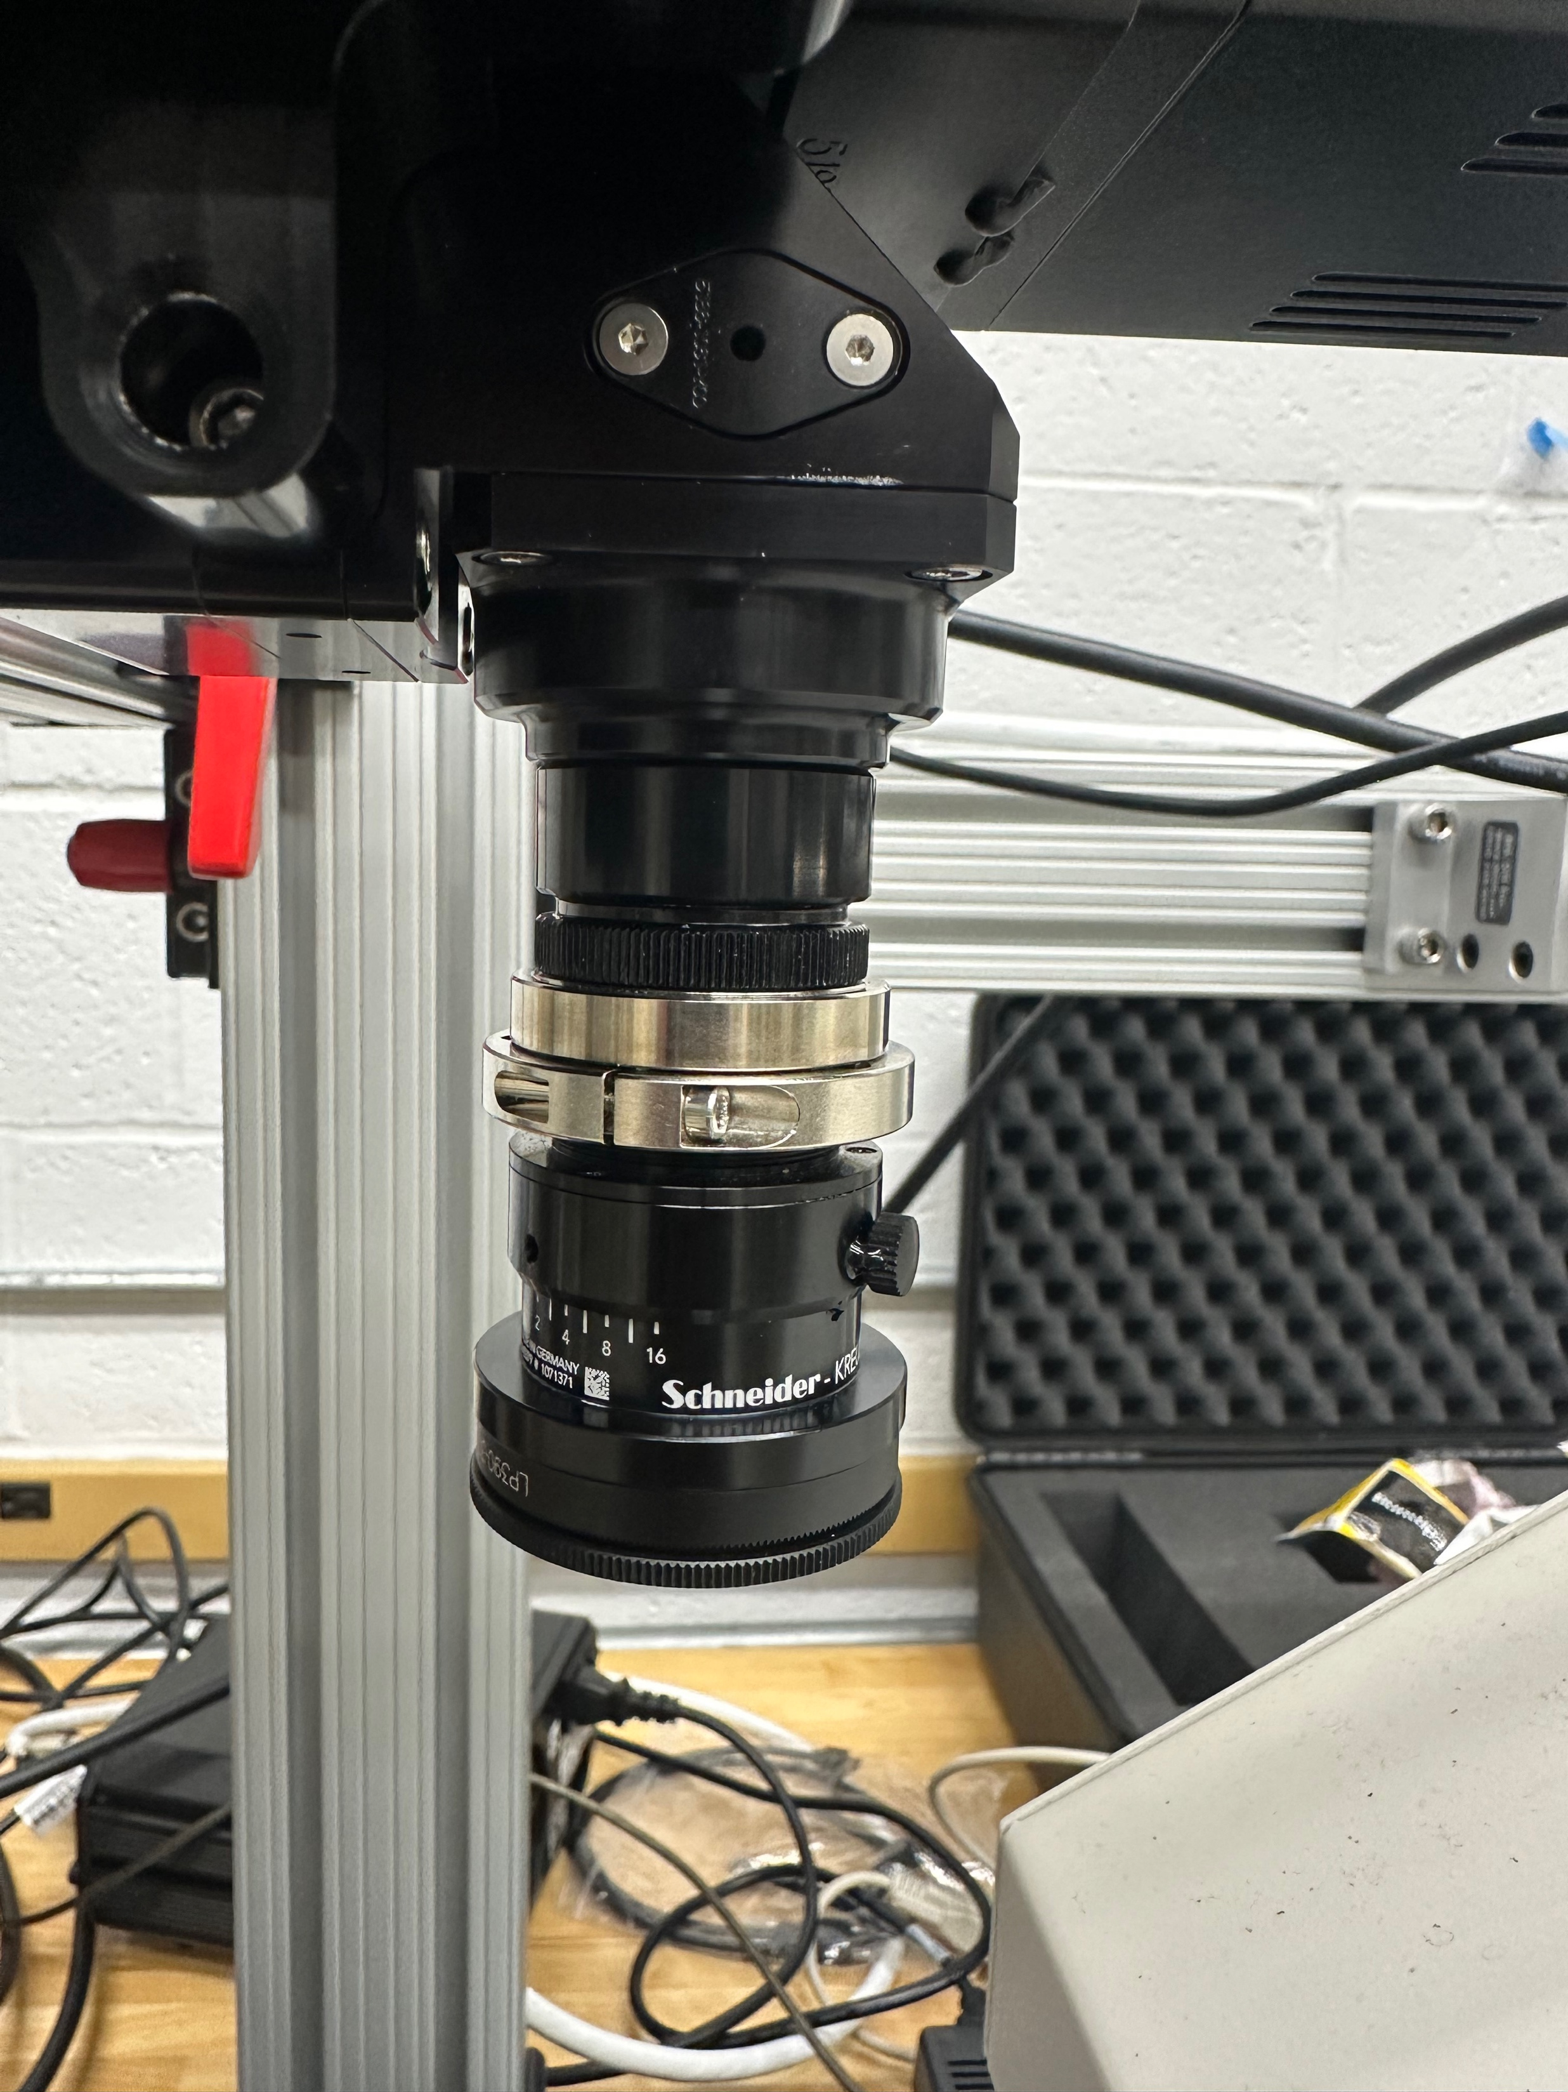
Detector
Notch Filter
Lens
Notes:
Problem: Need to protect camera detector from stray laser light that could damage it

Slide 29
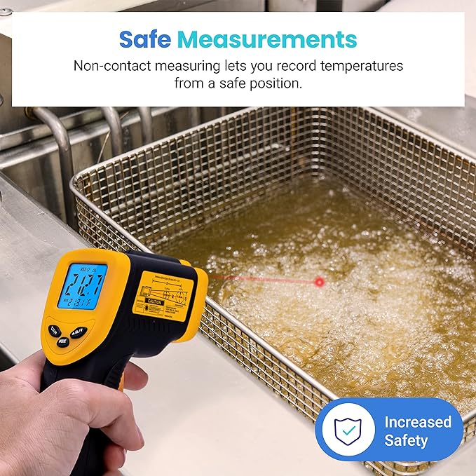
Part 2: Temperature Analysis
Etekcity Infrared Thermometer Temperature Gun 774, Digital IR Temp Gun for Food, Cooking, BBQ, Pizza Oven, Reptile, Griddle Accessories, Non Contact Surface Outdoor Heat Gun

Slide 30
Molten zone is a black-body
5500 K
Notes:
The shape of the black-body spectrum is unique to the temperature (for example, the wavelength of the peak), so we can determine temperature using the spectrum measured by the camera

Slide 31
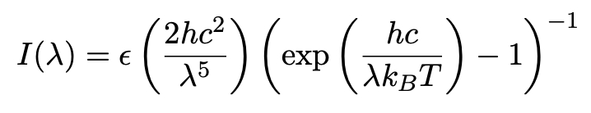
Notes:
Wavelength will be the independent variable, epsilon is emissivity

Slide 32
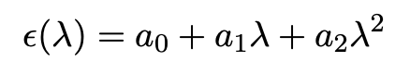

Slide 33
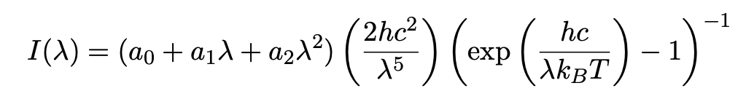

Slide 34
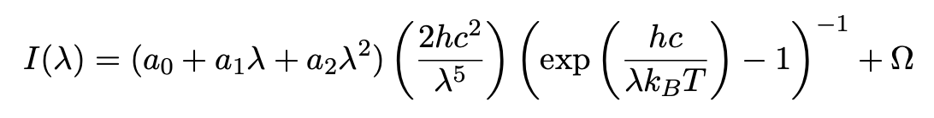

Slide 35
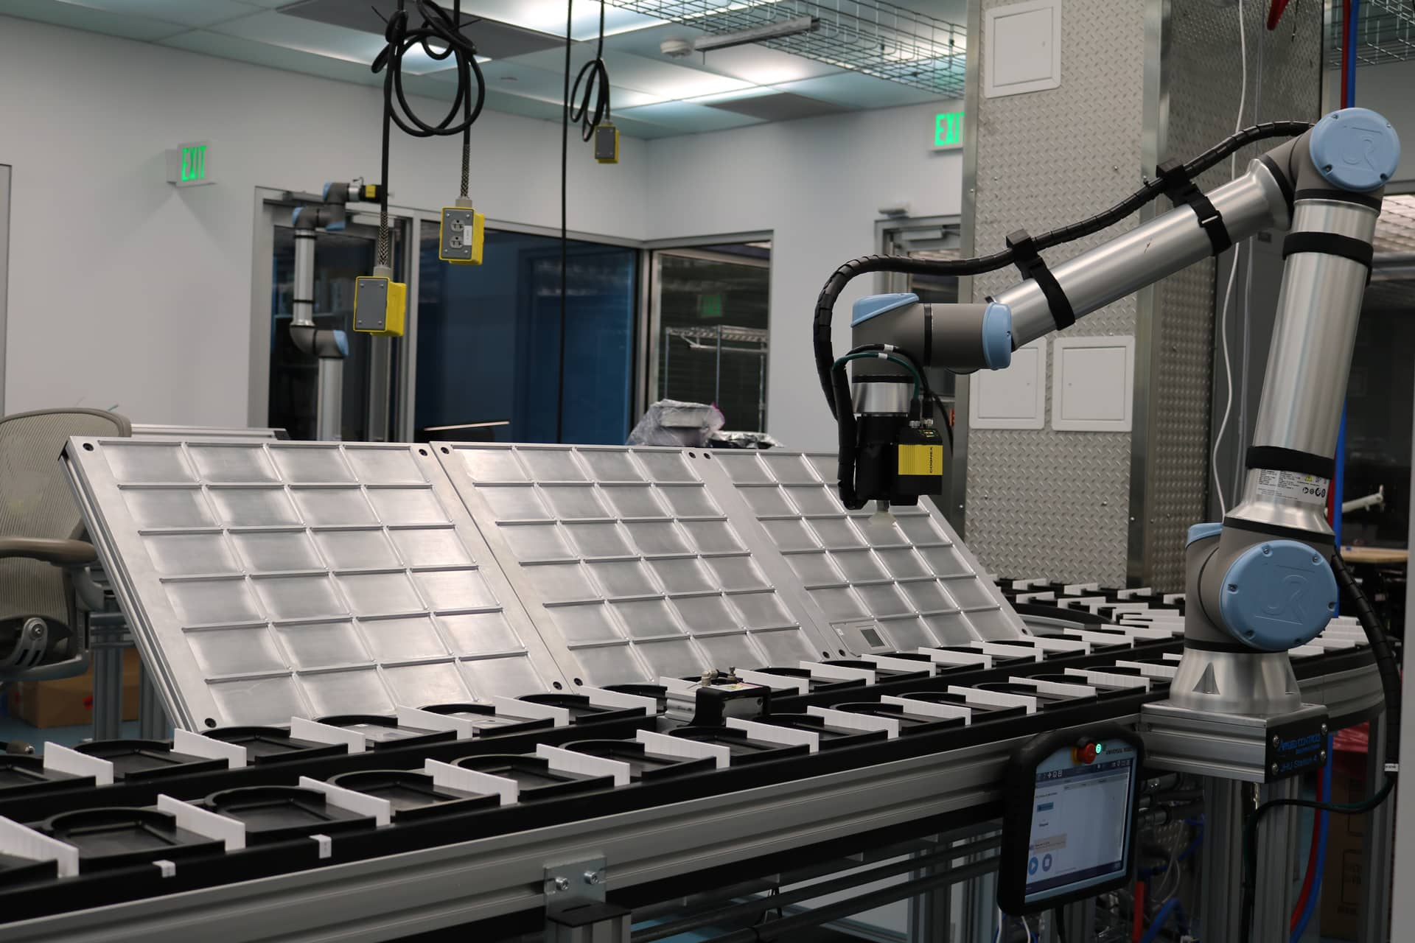
Part 3: Automate Everything

Slide 36
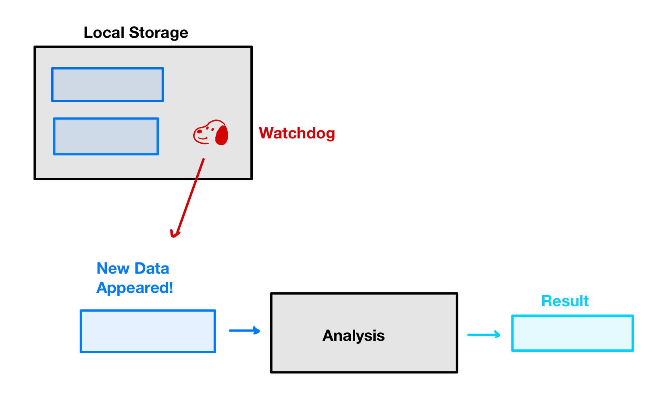

Slide 37
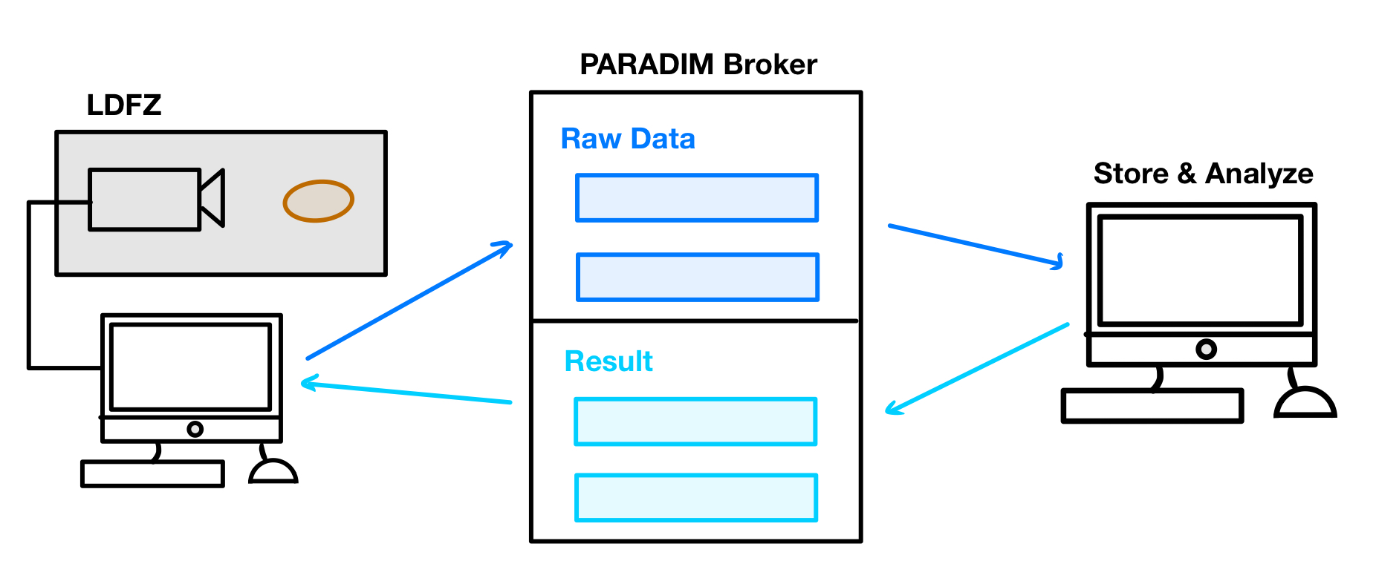

Slide 38
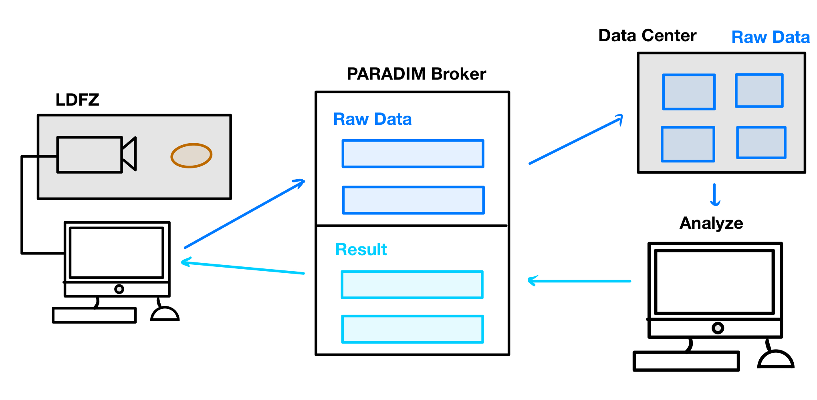

Slide 39
Now the science begins…

Slide 40
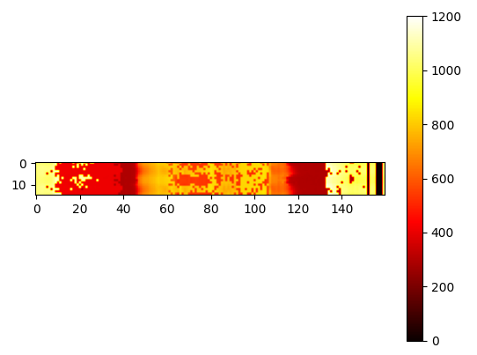

Slide 41
Acknowledgements
Tyrel for solving all my life’s problems

